Slide 1
Report of PAYROLL MANAGEMENT SYSTEM

Slide 2
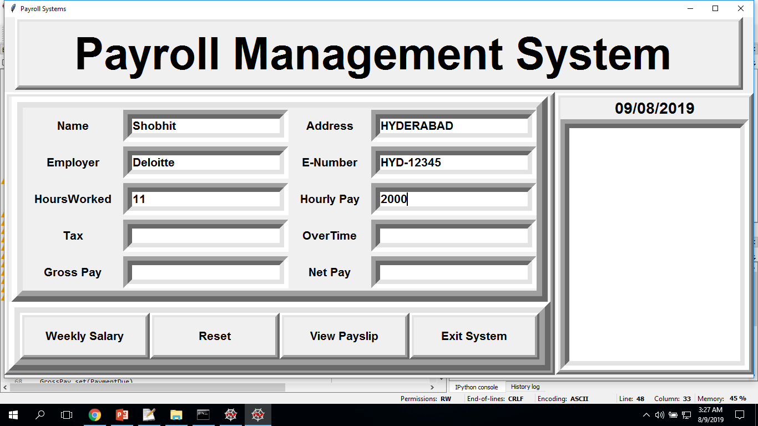
After Entering The Details :

Slide 3
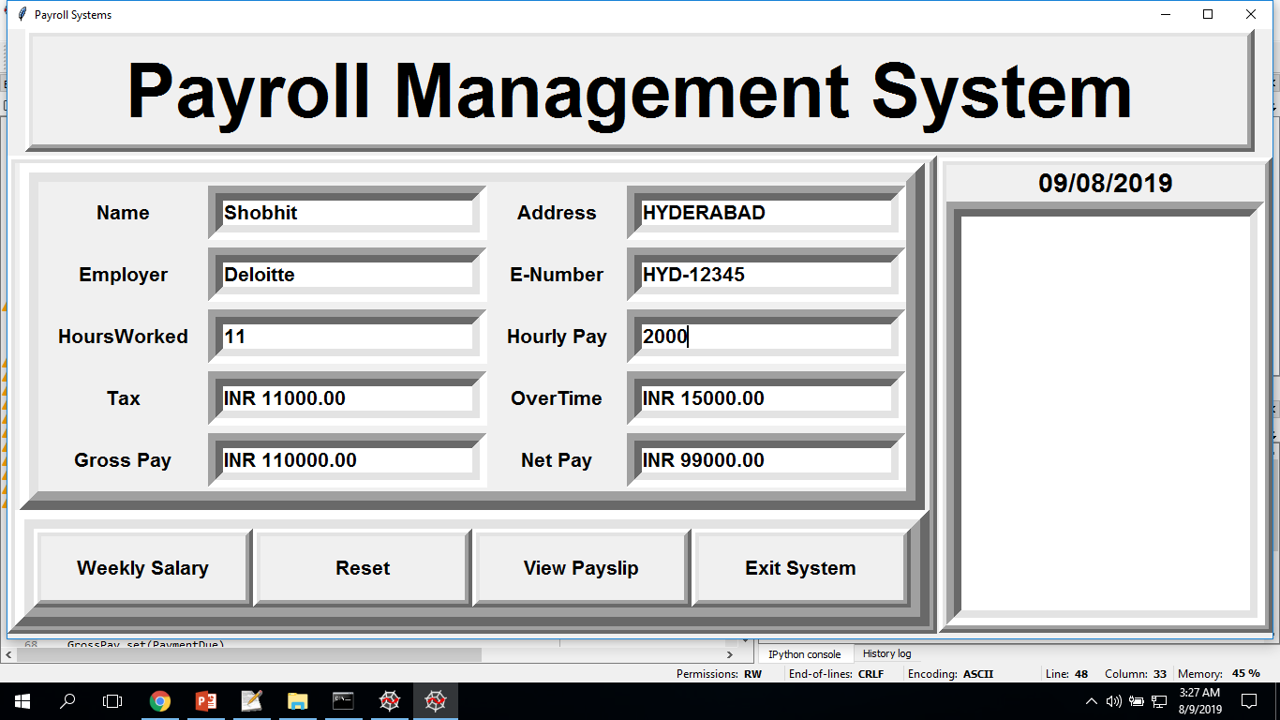
After Pressing The Weekly Salary Button :

Slide 4
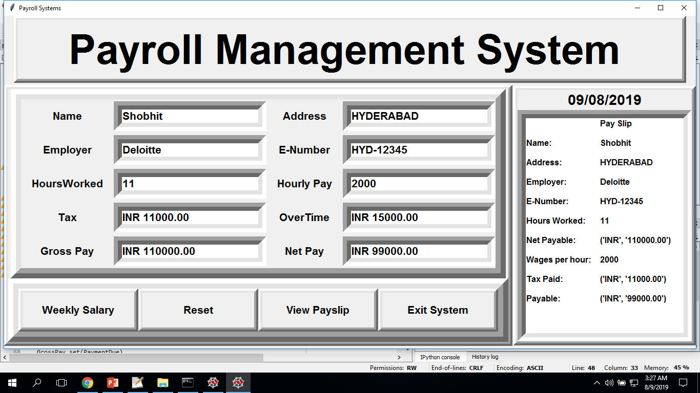
After Pressing The View Payslip Button :

Slide 5
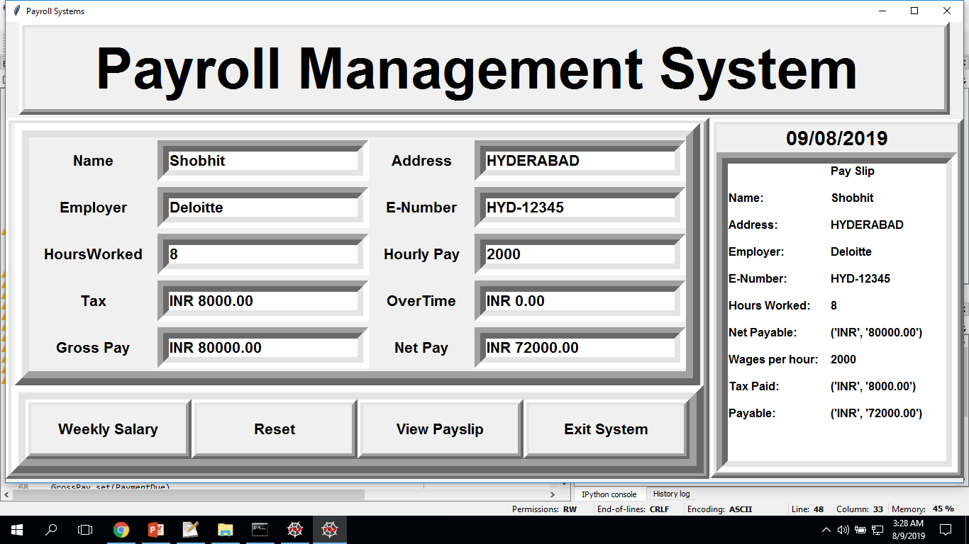
Editing The HoursWorked Text Field :

Slide 6
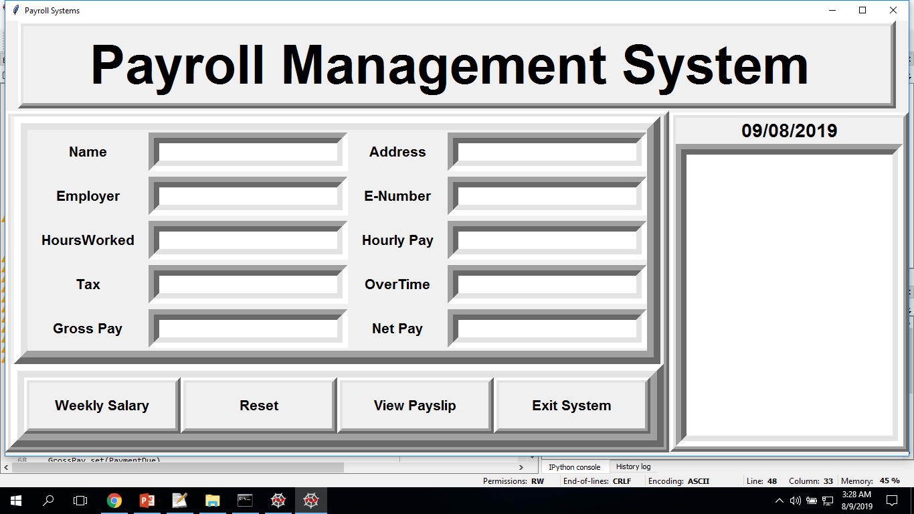
Resetting The Entered Field :

Slide 7
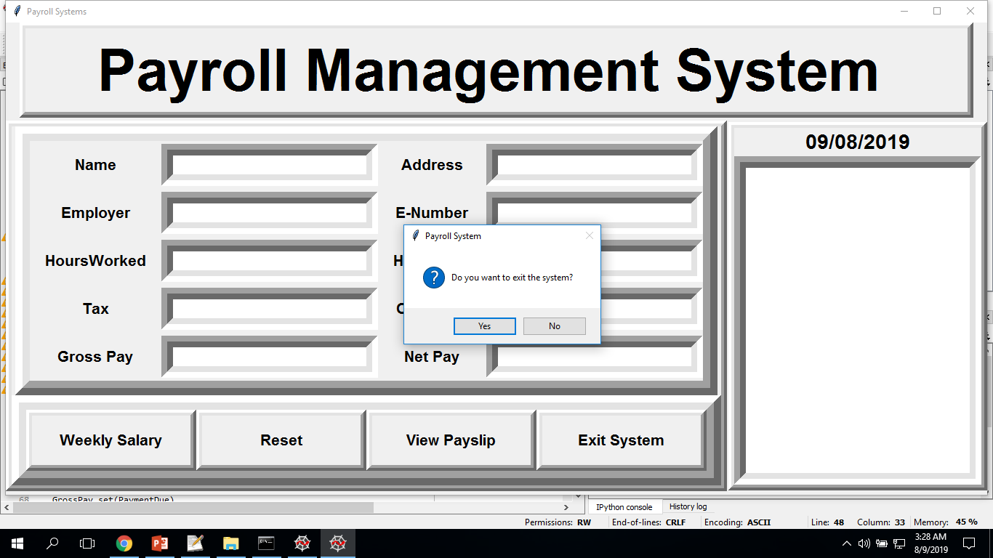
Pressing The Exit System Button :

